Slide 1
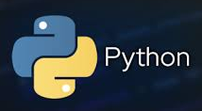
for Loop with Dictionaries
items() Function
for x, y in dict.items():
Print(x,y)
How to Iterate over a Dictionary using for loop?
- key()
- values()
- items()

